Slide 1
C++ Course
Games Academy Berlin 2015-05-20 - Day 2
Benjamin Nitschke - Delta Engine

Slide 2
Recap of Day 1
C++ Overview: Pros & Cons, IDEs, Setup, Structure
Test Driven Development
C++ Features
Objects
Data Hiding
Encapsulation
Inheritance
Polymorphism
Pointers
TextAdventure console game
Notes:
Quick recap of Day 1, ask if there are any questions from what was discussed yesterday

Slide 3
Text Adventures are so 70ies
Anyone can create a Text Adventure on a weekend
Today’s Games are
mostly 3D, some are 2D, 30+ or 60+fps
often using huge complex game engines with hundreds of man years of effort put into it
built by teams with hundreds or even thousands of people (GTA, Assassins Creed, Halo, WoW)
But small teams (indies) have a resurgence
casual games are popular again
better tools, engines, frameworks & languages today
Notes:
Hint: The game we are creating today also is from the 70ies :)
Everyone knows this already, we are just getting to the choices using C++
http://www.gamespot.com/articles/10-studios-are-working-on-assassin-s-creed-unity-that-s-three-more-than-ac4/1100-6419664/
http://www.futurelooks.com/resurgence-indie-gaming-scene/

Slide 4
So what are our choices?
Do everything yourself (impossible, need a base)
Use low level libraries (OpenGL, possible, but limited)
Use a framework (XNA, open source engine, etc.)
Use an engine like Unity3D or Unreal
Simple scripting (C#, Lua, Blueprint)
can work out if you have everything you need
but can also be too limiting (performance, flexibility, early Unreal games looked all similar)
Customization (C++, C#, Java)
Flexible, but harder, this is what big teams do

Slide 5
OpenGL
Let’s use OpenGL for today, it is a C library
Build on what we have learned yesterday
Knowing OpenGL well is always good
works on pretty much any platform (except xbox)
extremely popular on mobile and recently on web
old state machine like programming, no objects :(
teaches all the basics: devices, shaders, textures
Our goal today: Create Space Invaders & learn a lot more C++ by actually using it
Notes:
Even if you have done graphics programming before, we will learn more C++ today and how to use a C library like OpenGL and still stay true to what we have learned yesterday about TDD, objects, inheritance and polymorphism.
http://www.opengl-tutorial.org/

Slide 6
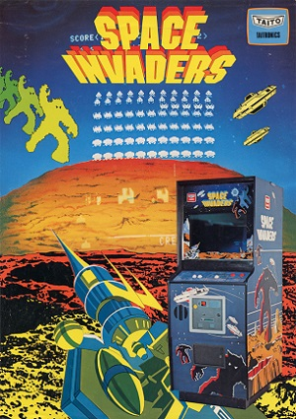
Space Invaders
Space Invaders is one of the earliest shooting games and the aim is to defeat waves of aliens with a laser cannon to earn as many points as possible.
Notes:
http://en.wikipedia.org/wiki/Space_Invaders

Slide 7
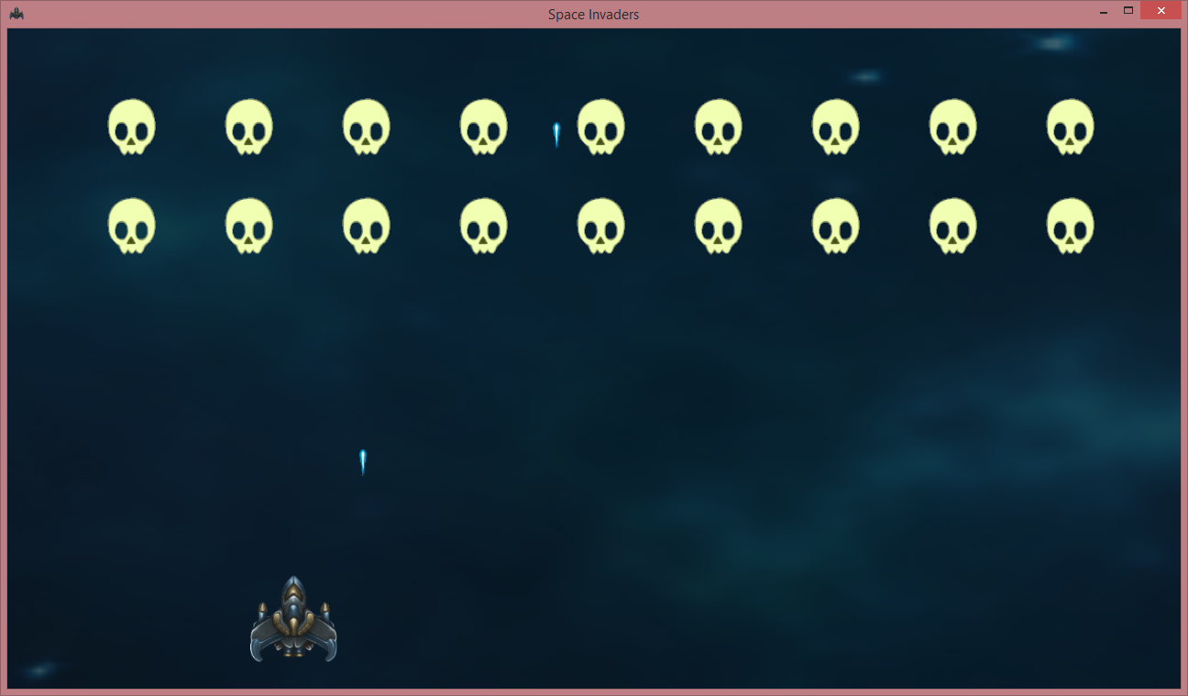
Space Invaders
Notes:
This is what our game will look like

Slide 8
Native OpenGL (Lesson 3 NeHe)
About 400 lines of C code needed to just setup the window and device
Which is not so bad, you would reuse this
However understanding all this will take some time
Let’s scroll through the code and see what is happening: Lesson3.cpp
Getting it to compile can be tricky
you need gl headers (available in VS) and
glaux (outdated), better to use glew (a bit better)
Notes:
file:///C:/code/Abi/Learning/Cpp/NeHeLessons/Lesson3.cpp
http://nehe.gamedev.net/tutorial/creating_an_opengl_window_(win32)/13001/
http://nehe.gamedev.net/tutorial/your_first_polygon/13002/
http://nehe.gamedev.net/tutorial/adding_colour/13003/

Slide 9
Testing UI code, especially GL is hard
We do it at Delta Engine, but it requires a framework built from the ground up for testing
Easier is to just use a framework (like GLFW) and test manually by visually confirming
Like in TextAdventure let’s try to start with tests and logic and then add graphics when the basics work
Notes:
Space Invaders actually does not have much game logic, but going through this process is usef

Slide 10
So what is this GLFW
GLFW is an Open Source, multi-platform library for creating windows with OpenGL contexts and receiving input and events. It is easy to integrate into existing applications and does not lay claim to the main loop.
GLFW is written in C and has native support for Windows, OS X and many Unix-like systems using the X Window System, such as Linux and FreeBSD.
Notes:
http://www.glfw.org/index.html
https://github.com/pjreddie/NeHe-Tutorials-Using-GLFW
Before we changed to our own native OpenGL implementation in our Delta Engine (mostly for faster startup) we used GLFW as our main testing framework, it worked very nice out of the box and provided us with better performance than OpenTK (which has also picked up speed recently). Btw: I am the OpenTK nuget maintainer.

Slide 11
GLFW Skeleton
Create a new C++ project “SpaceInvaders” in Visual Studio
#include <GLFW/glfw3.h> int _stdcall WinMain(struct HINSTANCE__ *hInstance, struct HINSTANCE__ *hPrevInstance,
char *lpszCmdLine, int nCmdShow) { glfwInit();
GLFWwindow* window = glfwCreateWindow(1280, 720, "Space Invaders", NULL, NULL); if (!window) { glfwTerminate(); return -1; }
glfwMakeContextCurrent(window);
while (!glfwWindowShouldClose(window))
{
glfwSwapBuffers(window);
glfwPollEvents(); } glfwTerminate(); return 0;
}
Notes:
This is much nicer than the native OpenGL code we looked at earlier, but after all very similar. GLFW is also a state machine on top of OpenGL, it is also very c like, see the pointer usage above and calling glfwInit and glfwTerminate instead of using objects.
GLFW is also easier to setup, let’s do it now in Visual Studio! Create a C++ Win32 project “SpaceInvaders” (but delete all code in SpaceInvaders.cpp and replace it with the above, remove all other files except stdafx, targetver.h).
Before using this code, download GLFW 3.1.1 (win 32bit binaries), extract it into your Cpp folder and setup the glfw include and lib-vc2013 directories (explained like yesterday).
Don’t forget to add the glfw3dll.lib to the linker input, also add opengl32.lib, which we will use later. Also copy the glfw3.dll to our output directory (can also be done as a post build step).
There is of course a ton of other things that can go wrong just with getting your first window project to work: http://stackoverflow.com/questions/4845410/error-lnk2019-unresolved-external-symbol-main-referenced-in-function-tmainc

Slide 12
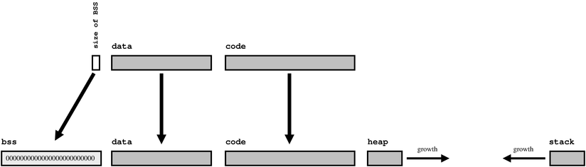
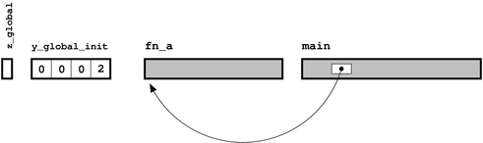
Short excursion about Linkers
How a Program is loaded and executed in memory as a Process:
How main() is found as the entry point:
(and from there any other method)
Notes:
Let’s try using main() like in the GLFW tutorial, why is the entry point not found?
http://www.lurklurk.org/linkers/linkers.html
http://en.wikipedia.org/wiki/.bss
http://en.wikipedia.org/wiki/Stack-based_memory_allocation
http://en.wikipedia.org/wiki/Memory_management#HEAP
Generally setting up a C++ project and using the corret static/dynamic debug/release threading/non threading libraries can be a pain in the ass:
http://stackoverflow.com/questions/23209/c-linker-unresolved-external-symbols?rq=1

Slide 13
Game class
Game::Game()
{
glfwInit();
window = glfwCreateWindow(1280, 720, "Space Invaders", NULL, NULL);
glfwMakeContextCurrent(window);
// More initialization later here
}
void Game::Run()
{
while (!glfwWindowShouldClose(window))
{
glClear(GL_COLOR_BUFFER_BIT);
// Game code goes here, plus input handling and timing before that
glfwSwapBuffers(window);
glfwPollEvents();
}
}
Game::~Game() { glfwTerminate(); }
Notes:
This is the same GLFW code as before, just nicely formatted in the new Game class.
Check with F4 (or ctrl+F5) if it still works as before. WinMain has to be changed to:
using namespace SpaceInvaders;
int _stdcall WinMain(struct HINSTANCE__ *hInstance, struct HINSTANCE__ *hPrevInstance,
char *lpszCmdLine, int nCmdShow)
{
Game().Run();
return 0;
}

Slide 14





Icon and Images
SpaceInvaders.ico
SpaceInvaders.rc
Ship.png Missile.png Enemy.png
Search for images you want for your game on the web
Background.png
GLFW_ICON ICON "SpaceInvaders.ico"
Notes:
The .ico and .rc files must be part of the Visual Studio project, all .png files must be put into the output folder (SpaceInvaders\Debug\)

Slide 15
Visual Tests
We are going to make a lot of little test programs.
Wouldn’t it be nice to have a bunch of programs like NeHe lessons to go back to?
We constantly want to adjust each of those
But setting up 20 programs is a pain in the ass
How to we even name the programs before we know what each of them will do? Hard to refactor
-> Visual Tests to the rescue!
Notes:
More details at: http://deltaengine.net/learn/codingstylecpp
Visual Tests are also often called functional tests or manual tests.

Slide 16
Visual Tests
Visual Tests are similar to unit tests, but we execute them manually via this class:
class SpaceInvadersVisualTests : public Game
{
public:
void ShowEmptyWindow()
{
Run([](){});
}
}
void Game::Run(std::function<void()> tickMethod)
{
while (!glfwWindowShouldClose(window))
{
tickMethod();
glfwSwapBuffers(window);
glfwPollEvents();
}
}
Notes:
Let’s create a new SpaceInvadersVisualTests Win32 console project because we want to execute those new tests manually in the main method. Add this main method to start testing:
int _stdcall WinMain(struct HINSTANCE__ *hInstance, struct HINSTANCE__ *hPrevInstance,
char *lpszCmdLine, int nCmdShow)
{
SpaceInvadersVisualTests::SpaceInvadersVisualTests().ShowEmptyWindow();
return 0;
}

Slide 17
Lambdas & Function pointers
Generic lambda, with or without parameters
[]() { return 1; }
e.g. void ShowEmptyWindow() { Run([](){}); }
[](int first, int second) { return first + second; }
Pass variables along into lambda, = for all, & for references
[=](int value) { return outerVariable + value; }
[copyValue, &referenceValue]() { copyValue++; referenceValue++; }
copyValue is only changed inside, referenceValue exists outside
Use std::function to hold lambdas or define functions
void Run(std::function<void()> tickMethod) { … }
Without C++11 it would be: void (*tickMethod)(void*)
Notes:
http://en.cppreference.com/w/cpp/language/lambda
Yeah, lambdas looks funny in C++, they and std::function are only available since C++11, before simple pointers had to be used like: void (*fptr)(void*, int, int)

Slide 18
Draw a blue background
Let’s write a new visual test (like in ShowEmptyWindow, do nothing in Run).
glClearColor sets the OpenGL clear color, but it expects floats (0.0-1.0)
Starting this (F4 or Ctrl+F5) does still show a black window, what did we do wrong? Ohh, we actually never called glClear yet. Add it to Run.
void ShowBlueBackground()
{
glClearColor(100 / 255.0f, 149 / 255.0f, 237 / 255.0f, 1.0f);
Run([](){});
}
...
glClear(GL_COLOR_BUFFER_BIT);
tickMethod();
glfwSwapBuffers(window);
...
Notes:
Repeating the test process for visual tests is even more important as for unit tests, especially since we have to manually confirm that they are working. Things might break if we do changes, but we can always go back and confirm things are still good.

Slide 19
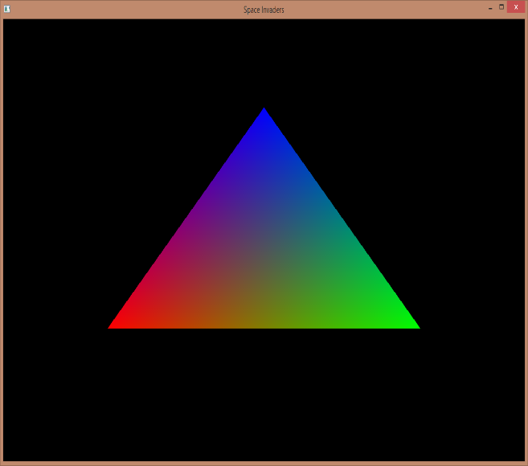
DrawColoredTriangle
void DrawColoredTriangle()
{
Run([]()
{
glBegin(GL_TRIANGLES);
glColor3f(1.f, 0.f, 0.f);
glVertex3f(-0.6f, -0.4f, 0.f);
glColor3f(0.f, 1.f, 0.f);
glVertex3f(0.6f, -0.4f, 0.f);
glColor3f(0.f, 0.f, 1.f);
glVertex3f(0.f, 0.6f, 0.f);
glEnd();
});
}
Notes:
Explain gl calls. This is called immediate mode and very outdated, glfw still supports it, but modern OpenGL is all about using shaders and vertex buffers, which we will NOT cover today, this is not a course about graphics programming after all.

Slide 20
DrawTexturedBackground
Even though we do not have image loading functionality, let’s assume we do:
void DrawTexturedBackground()
{
auto texture = std::make_shared<Texture>("Background.png");
Run([=]()
{
glBindTexture(GL_TEXTURE_2D, texture->GetHandle());
glEnable(GL_TEXTURE_2D);
glBegin(GL_QUADS);
glTexCoord2d(0, 0); glVertex3f(-1, -1, 0);
glTexCoord2d(0, 1); glVertex3f(-1, 1, 0);
glTexCoord2d(1, 1); glVertex3f(1, 1, 0);
glTexCoord2d(1, 0); glVertex3f(1, -1, 0);
glEnd();
});
}
Notes:
Notice how we pass the texture automatically into the lambda. The UV and position are to match the default screenspace, the image is already flipped by the png loader.
This will not compile, create an empty Texture class to make it compile and then we have to think about the missing texture functionality.

Slide 21
Loading png images
Unlike .NET or Java there is no Bitmap class and build in image loading functionality out of the box in C++, neither in std, gl or glfw. We use libpng here!
Download libpng1617.7z: http://sourceforge.net/projects/libpng/files/
Compile lpng1617\projects\vstudio\vstudio.sln
which needs zlib-1.2.8 download it as well: http://www.zlib.net/
Let’s add a new class to the SpaceInvaders project and name it Texture
Copy this code into Texture.cpp, call it and add a GetHandle getter: https://github.com/DavidEGrayson/ahrs-visualizer/blob/master/png_texture.cpp
If it does not work anymore or we need to do changes, we should refactor!
Since we did not really write this code ourselves, don’t work, should work.
The destructor should cleanup the texture. In native code, but especially when using native libraries like OpenGL we should take good care of cleanup.
Notes:
https://github.com/DavidEGrayson/ahrs-visualizer/blob/master/png_texture.cpp
Also use linear filtering and fix the compiler warnings by using safer methods:
glTexParameterf(GL_TEXTURE_2D, GL_TEXTURE_MAG_FILTER, GL_LINEAR);
glTexParameterf(GL_TEXTURE_2D, GL_TEXTURE_MIN_FILTER, GL_LINEAR);
Going through all this for the first time is painful and confusing, but an important skill for any C++ programmer, libraries galore!

Slide 22
Texture class
#include <GLFW/glfw3.h>
#include <GL/gl.h>
#include <string>
namespace SpaceInvaders
{
class Texture
{
public:
Texture(std::string filename);
class ImageNotFound : public std::exception {};
~Texture();
int GetHandle()
{
return handle;
}
private:
GLuint handle;
int width;
int height;
};
}
using namespace SpaceInvaders;
GLuint png_texture_load(const char * file_name,
int * width, int * height)
{
...
}
Texture::Texture(std::string filename)
{
handle = png_texture_load(filename.c_str(),
&width, &height);
if (handle == 0)
throw ImageNotFound();
}
Texture::~Texture()
{
glDeleteTextures(1, &handle);
}

Slide 23
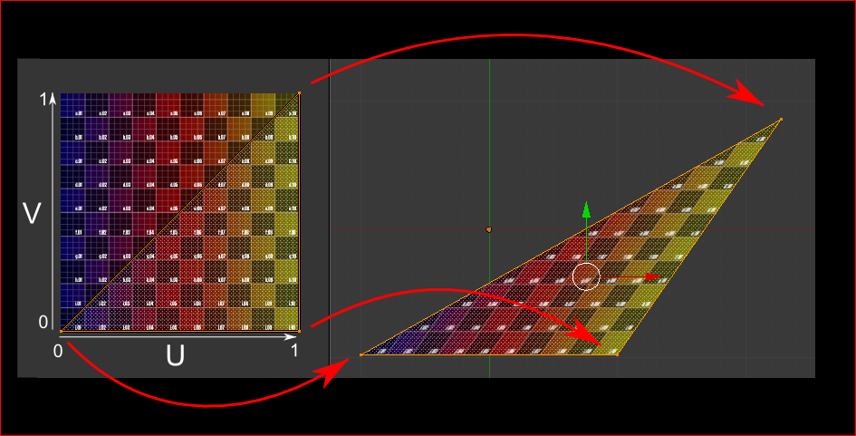
Understanding UVs
UVs can be used to specify which parts of an image are drawn where on screen. We always will use the default (0, 0, 1, 1) full UVs for everything.
Notes:
http://www.opengl-tutorial.org/beginners-tutorials/tutorial-5-a-textured-cube/

Slide 24
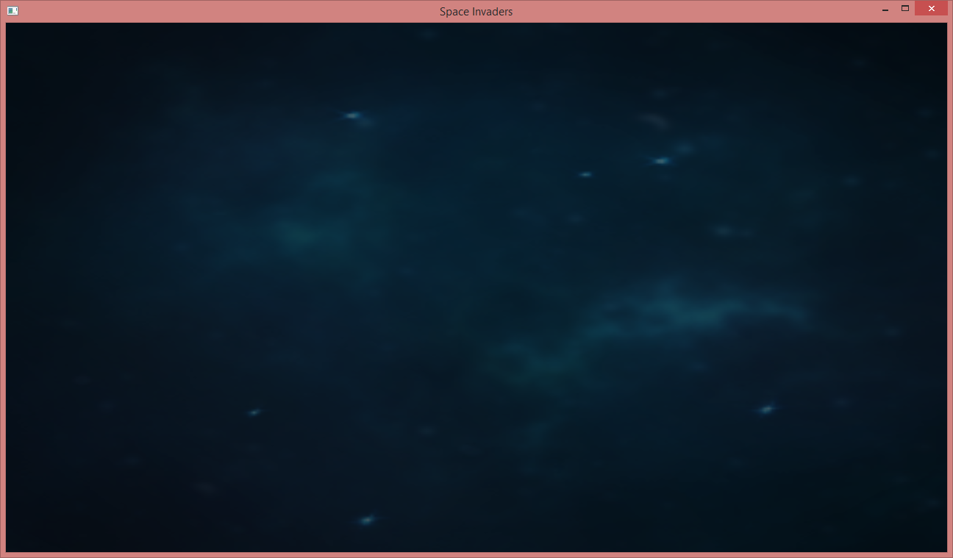
DrawTexturedBackground
Notes:
All the hard work pays off, a static background image ^^

Slide 25
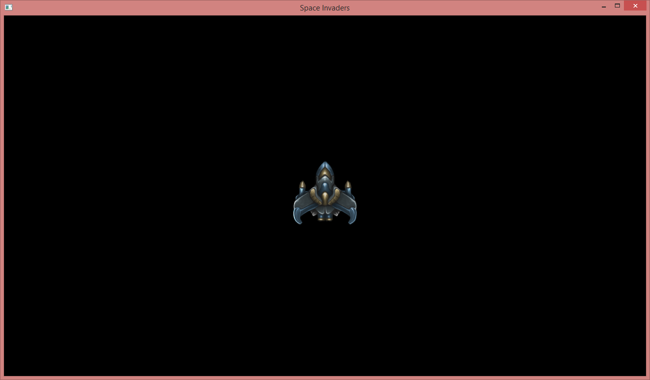
DrawShip
void DrawShip()
{
auto texture = std::make_shared<Texture>("Ship.png");
Run([=]()
{
glBindTexture(GL_TEXTURE_2D, texture.GetHandle());
glBegin(GL_QUADS);
glTexCoord2d(0, 0); glVertex3f(-0.1f, -0.2f, 0);
glTexCoord2d(0, 1); glVertex3f(-0.1f, 0.2f, 0);
glTexCoord2d(1, 1); glVertex3f(0.1f, 0.2f, 0);
glTexCoord2d(1, 0); glVertex3f(0.1f, -0.2f, 0);
glEnd();
});
}
Well, it works, but we are really repeating ourselves!
Notes:
Notice how we pass the texture automatically into the lambda. The UV and position orders are because OpenGL has the origin at the lower left while the image is loaded from top to bottom.

Slide 26
Sprite class to reuse rendering code
Start with how we want to use Sprites from tests or game code:
void DrawTexturedBackground()
{
auto background =
std::make_shared<Sprite>(std::make_shared<Texture>("Background.png"), 2.0f, 1.0f);
Run([=]() { background->Draw(0, 0); });
}
void DrawShip()
{
auto sprite =
std::make_shared<Sprite>(std::make_shared<Texture>("Ship.png"), 0.075f, 0.075f);
Run([=]() { sprite->Draw(0, 0); });
}
Notes:
Since we did not touch viewport matrices, it goes from -1 to +1, which is 2.0 and we multiply heights by 2, so 2, 1 is required to fill the whole screen with this code.

Slide 27
Sprite class to reuse rendering code
Next up, design Sprite.h (use empty implementation to get things to compile)
class Sprite
{
public:
// Since we did not touch viewport matrices, the screen goes from -1 to +1, which is 2.0 and we
// multiply heights by 2, so 2, 1 is required to fill the whole screen with this code.
Sprite(std::shared_ptr<Texture> texture, float width, float height)
: texture(texture), width(width), height(height * 2.0f) {}
void Draw(float x, float y);
private:
std::shared_ptr<Texture> texture;
float width;
float height;
};
Notes:
Obviously running the visual tests will not show anything on screen now until we actually implement Sprite.Draw.

Slide 28
Sprite class to reuse rendering code
void Sprite::Draw(float x, float y)
{
glBindTexture(GL_TEXTURE_2D, texture->GetHandle());
glEnable(GL_TEXTURE_2D);
glBegin(GL_QUADS);
glTexCoord2d(0, 0);
glVertex3f(x - width, y - height, 0);
glTexCoord2d(0, 1);
glVertex3f(x - width, y + height, 0);
glTexCoord2d(1, 1);
glVertex3f(x + width, y + height, 0);
glTexCoord2d(1, 0);
glVertex3f(x + width, y - height, 0);
glEnd();
}
Notes:
Not the prettiest code, works because our screen space goes from -1 to +1, thus -width to +width is actually how big things are (-0.1 to +0.1 is 10% of the screen)

Slide 29
Input
Let’s support Keyboard Cursors for now
GLFW_KEY_LEFT
GLFW_KEY_RIGHT
Other possibilities (up to you)
GamePad
Mouse
Touch (if you have a touch device)
Gestures (Kinect, Intel RealSense, etc.)

Slide 30
ControlShip
Let’s move our ship around
void ControlShip()
{
auto ship = std::make_shared<Sprite>(std::make_shared<Texture>("Ship.png"), 0.075f, 0.075f);
float shipPosition = 0;
Run([=, &shipPosition]()
{
if (leftPressed && shipPosition > -1.0f + ship->GetWidth())
shipPosition -= GetTimeDelta();
if (rightPressed && shipPosition < 1.0f - ship->GetWidth())
shipPosition += GetTimeDelta();
ship->Draw(shipPosition, -0.8f);
});
}
Notes:
Again, just write down some code, improve over time. We can start with 0.01 instead of GetTimeDelta and then discuss that problem next.

Slide 31
ControlShip
Where is this leftPressed and rightPressed coming from?
bool Game::leftPressed;
bool Game::rightPressed;
void OnKeyPressed(GLFWwindow* window, int key, int scancode, int action, int mods)
{
if (key == GLFW_KEY_LEFT)
Game::leftPressed = action != GLFW_RELEASE;
else if (key == GLFW_KEY_RIGHT)
Game::rightPressed = action != GLFW_RELEASE;
}
Game::Game()
{
...
glfwSetKeyCallback(window, OnKeyPressed);
}
Notes:
For details see http://www.glfw.org/docs/latest/input.html
Also press F12 on constants and types to find out more, e.g. GLFW_RELEASE is better than checking just GLFW_PRESS as we need to set these booleans to true for GLFW_REPEAT as well.

Slide 32
ControlShip: Timing
Game.h Game.cpp
class Game
{
public:
Game();
~Game();
void Run(std::function<void()> tickMethod);
void PlayGame();
static bool leftPressed;
static bool rightPressed;
float GetTimeDelta()
{ return static_cast<float>(timeThisTick); }
private:
GLFWwindow* window;
double time;
double timeThisTick;
double lastTime;
};
void Game::Run(std::function<void()> tickMethod)
{
int viewportWidth, viewportHeight;
lastTime = glfwGetTime();
while (!glfwWindowShouldClose(window))
{
glfwGetWindowSize(window, &viewportWidth, &viewportHeight);
glViewport(0, 0, viewportWidth, viewportHeight);
glClear(GL_COLOR_BUFFER_BIT);
time = glfwGetTime();
timeThisTick = time - lastTime;
lastTime = time;
tickMethod();
glfwSwapBuffers(window);
glfwPollEvents();
}
}
Notes:
For details see http://www.glfw.org/docs/3.0/group__time.html

Slide 33
DrawEnemies
Let’s create a list of enemies (with initial positions)
void DrawEnemies()
{
auto enemyTexture = std::make_shared<Texture>("Enemy.png");
std::vector<Sprite> enemies;
for (float y = 0.7f; y > 0.3f; y -= 0.3f)
for (float x = -0.8f; x <= 0.8f; x += 0.2f)
enemies.push_back(Sprite(enemyTexture, x, y, 0.05f, 0.05f));
Run([=]()
{
for (auto enemy : enemies)
enemy.Draw();
});
}
Notes:
We extend the Sprite constructor to have x and y values also (before width and height). This means we need to change the previous tests as well.
Make the Draw x and y optional as we do not need them for the previous tests except for ControlShip and here as we want to move the enemies around.

Slide 34
MoveEnemies
Move enemies creation into an extra reusable CreateEnemies method!
void MoveEnemies()
{
auto enemies = CreateEnemies();
float enemiesPosition = 0;
bool enemiesMovingRight = true;
Run([=, &enemiesPosition, &enemiesMovingRight]()
{
enemiesPosition += (enemiesMovingRight ? 0.2f : -0.2f) * GetTimeDelta();
if (enemiesPosition < -0.1f || enemiesPosition > 0.1f)
enemiesMovingRight = !enemiesMovingRight;
for (auto enemy : enemies)
enemy.Draw(enemiesPosition);
});
}

Slide 35
Move reusable code into Game.h
class Game
{ ...
void CreateBackground();
void CreateShip();
void ControlShip();
void CreateEnemies();
void MoveEnemies();
void DrawAll();
private:
GLFWwindow* window;
double time;
double timeThisTick;
double lastTime;
std::shared_ptr<Sprite> background;
std::shared_ptr<Sprite> ship;
float shipPosition = 0;
std::vector<std::shared_ptr<Sprite>> enemies;
float enemiesPosition = 0;
bool enemiesMovingRight = true;
Notes:
Step by step of course, but this is hard to show here ..

Slide 36
Move reusable code into Game.cpp
void Game::CreateBackground()
{
background = std::make_shared<Sprite>(std::make_shared<Texture>("Background.png"),
0.0f, 0.0f, 2.0f, 1.0f);
}
void Game::CreateShip()
{
ship = std::make_shared<Sprite>(std::make_shared<Texture>("Ship.png"),
0.0f, -0.8f, 0.075f, 0.075f);
}
void Game::ControlShip()
{
if (leftPressed && shipPosition > -1.0f + ship->GetWidth())
shipPosition -= GetTimeDelta();
if (rightPressed && shipPosition < 1.0f - ship->GetWidth())
shipPosition += GetTimeDelta();
}
.. continued
Notes:
Step by step of course, but this is hard to show here ..

Slide 37
Move reusable code into Game.cpp
.. continued
void Game::CreateEnemies()
{
auto enemyTexture = std::make_shared<Texture>("Enemy.png");
for (float y = 0.7f; y > 0.3f; y -= 0.3f)
for (float x = -0.8f; x <= 0.8f; x += 0.2f)
enemies.push_back(std::make_shared<Sprite>(enemyTexture, x, y, 0.05f, 0.05f));
}
void Game::MoveEnemies()
{
enemiesPosition += (enemiesMovingRight ? 0.2f : -0.2f) * GetTimeDelta();
if (enemiesPosition < -0.1f || enemiesPosition > 0.1f)
enemiesMovingRight = !enemiesMovingRight;
}
.. continued
Notes:
Step by step of course, but this is hard to show here ..
Notice that we changed the enemies vector to use shared_ptr<Sprite> so we can simply modify them, using the

Slide 38
Move reusable code into Game.cpp
.. continued
void Game::DrawAll()
{
if (background)
background->Draw();
if (ship)
ship->Draw(shipPosition);
for (auto enemy : enemies)
enemy->Draw(enemiesPosition);
}
Notes:
Step by step of course, but this is hard to show here ..

Slide 39
Shoot missiles
We are almost done, we just need to shoot those pesky enemies, we can test shooting missiles via the existing ControlPlayerShip method and by extending ControlShip next:
void ShootMissiles()
{
CreateShip();
Run([=]()
{
ControlShip();
DrawAll();
});
}
Notes:
Step by step of course, but this is hard to show here ..

Slide 40
Shoot missiles
Some methods have to be extended, let’s start with input (compile and test each change!)
void Game::ControlShip()
{
if (leftPressed && shipPosition > -1.0f + ship->GetWidth())
shipPosition -= GetTimeDelta();
if (rightPressed && shipPosition < 1.0f - ship->GetWidth())
shipPosition += GetTimeDelta();
if (spacePressed && lastTimeShot < time - 0.5f)
FireMissile();
}
bool Game::spacePressed;
void OnKeyPressed(GLFWwindow* window, int key, int scancode, int action, int mods)
{ ...
else if (key == GLFW_KEY_SPACE)
Game::spacePressed = action != GLFW_RELEASE;
else if (key == GLFW_KEY_ESCAPE)
glfwSetWindowShouldClose(window, true);
}
Notes:
Step by step of course, but this is hard to show here ..

Slide 41
Shoot missiles
Add a list of active missiles to Game.h and create missile in the new FireMissile method
void Game::FireMissile()
{
lastTimeShot = time;
activeMissiles.push_back(std::make_shared<Sprite>(missileTexture, shipPosition, -0.67f, 0.02f, 0.02f));
}
And draw them before the player ship and enemies in the DrawAll method:
void Game::DrawAll()
{
if (background)
background->Draw();
for (auto missile : activeMissiles)
missile.Draw();
if (ship)
ship->Draw(shipPosition);
for (auto enemy : enemies)
enemy->Draw(enemiesPosition);
}

Slide 42
Fly missile fly
Add a HandleMissiles method, which just moves them up (and does collision detection next)
void Game::HandleMissiles()
{
activeMissiles.erase(std::remove_if(activeMissiles.begin(), activeMissiles.end(),
[=](Sprite missile) { return missile.IncreaseY(GetTimeDelta() * 3); }), activeMissiles.end());
}
And call it from the ControlShip method (they kind of belong to our ship)
void Game::ControlShip()
{
if (leftPressed && shipPosition > -1.0f + ship->GetWidth())
shipPosition -= GetTimeDelta();
if (rightPressed && shipPosition < 1.0f - ship->GetWidth())
shipPosition += GetTimeDelta();
if (spacePressed && lastTimeShot < time - 0.5f)
FireMissile();
HandleMissiles();
}
Notes:
http://stackoverflow.com/questions/4713131/removing-item-from-vector-while-iterating

Slide 43
Put it all together in PlayGame
void DrawTexturedBackground()
{
CreateBackground();
Run([=]() { DrawAll(); });
}
void Game::PlayGame()
{
CreateBackground();
CreateShip();
CreateEnemies();
Run([=]()
{
ControlShip();
MoveEnemies();
DrawAll();
});
}
void ControlPlayerShip()
{
CreateShip();
Run([=]() { ControlShip(); DrawAll(); });
}
void MoveAllEnemies()
{
CreateEnemies();
Run([=]() { MoveEnemies(); DrawAll(); });
}
Wow, our game is done! Just start the SpaceInvaders project, you will see the full game.
Notes:
Step by step of course, but this is hard to show here ..

Slide 44
The finished game so far
Notes:
A bit boring without killing those enemies, let’s do something about that.

Slide 45
Collision detection
Let’s extend the HandleMissiles method and “kill” any enemy our missile gets close to
void Game::HandleMissiles()
{
activeMissiles.erase(std::remove_if(activeMissiles.begin(), activeMissiles.end(),
[=](std::shared_ptr<Sprite> missile)
{
return missile->IncreaseY(GetTimeDelta() * 3) || CollidingWithEnemyAndKilledIt(missile);
}),
activeMissiles.end());
}
bool Game::CollidingWithEnemyAndKilledIt(std::shared_ptr<Sprite> missile)
{
for (auto enemy : enemies)
if (enemy->DistanceTo(missile, enemiesPosition) < 0.05f)
{
enemy->IncreaseY(1.0f); // Move out of screen
return true;
}
return false;
}
Notes:
http://stackoverflow.com/questions/4713131/removing-item-from-vector-while-iterating

Slide 46
Make it juicy
https://www.youtube.com/watch?v=Fy0aCDmgnxg
Play your own game
A lot!
Very similar to TDD
test, then stop as you notice something
fix & improve
repeat
Optimize as well
we overuse shared_ptr
use more const and & references
Notes:
This is a BIG topic and can eat up a lot of time, which we will probably not have as solving C++ problems for everyone will eat up a lot of time.
Clarify a bit more about shared_ptr overuse, performance implications, using more const, cleaning up code, using the & reference operator more often so we do not call copy constructors all the time we pass things along, etc.

Slide 47
Questions?
All code and these slides are available at:
https://github.com/BenjaminNitschke/CppCourse/Day2

Slide 48
OpenGL C++ Books
OpenGL SuperBible (Wright, Haemel, Sellers)
http://openglbook.com/
Essential 3D Game Programming: with C++ and OpenGL
The OpenGL Programming Guide: The Official Guide to Learning OpenGL Version 3
OpenGL(R) ES 2.0 Programming Guide
Game Programming Gems 1-8
Notes:
You will learn the most and the fastest if you have a topic (like graphics programming) that interests you, OpenGL is very closely tied to how C works, so if you know one well, you are likely also good at the other technology too.

Slide 49
OpenGL C++ Links
http://www.glfw.org/
https://www.opengl.org/
http://glew.sourceforge.net/
http://nehe.gamedev.net/
http://www.opengl-tutorial.org/
https://www.opengl.org/sdk/docs/tutorials/
https://www.opengl.org/sdk/docs/
https://www.chromeexperiments.com/webgl
Notes:
Also see C++ links from yesterday

